Slide 1

MOBILE APPLICATION Development (114155)
Dr. Owais Hussain

Slide 2
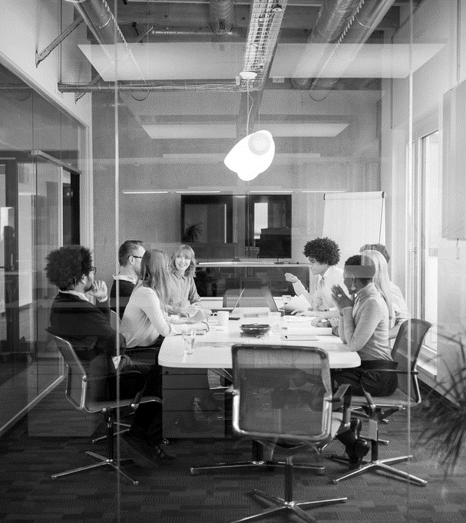
Agenda
Principles of Material UI
Material UI Guidelines
Colour Theory
UX-based Design
UX-based Design Examples

Slide 3
Sample 2
Principles of Material UI
Material: design should be inspired by the physical world. Like, using realistic motion and tactile surfaces.
Meaningfulness: each visual element should be associated with the context to facilitate user in a glance.
Motion: motion should be an essential part of design. Transitions between states should be smooth and aligned with spatial aspects.
User action focused: design should follow user’s actions. For example, most frequently used actions should be readily available.
Consistency/Responsiveness: user should get a consistent experience across different devices and screen sizes.
Accessibility: design should emphasize accessibility, ensuring that users with diverse abilities can also use the application.

Slide 4
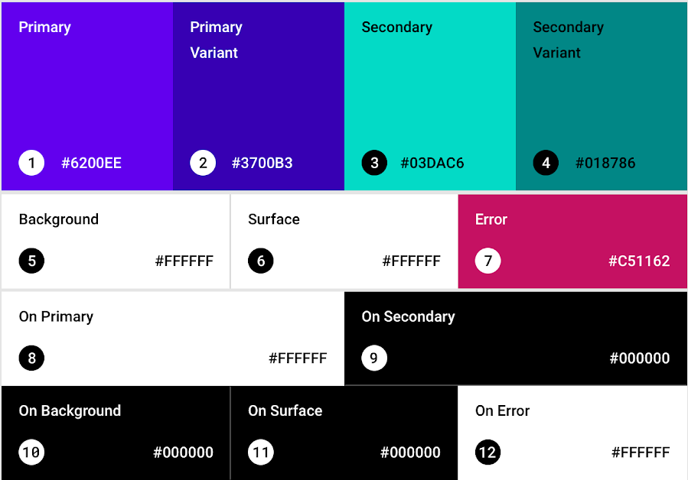
Sample 2
Material UI Guidelines – Colours
Implement a Colour theme.
Pick Primary, Secondary and Background colours before choosing variants.
Notes:
Guidelines from: https://m2.material.io

Slide 5
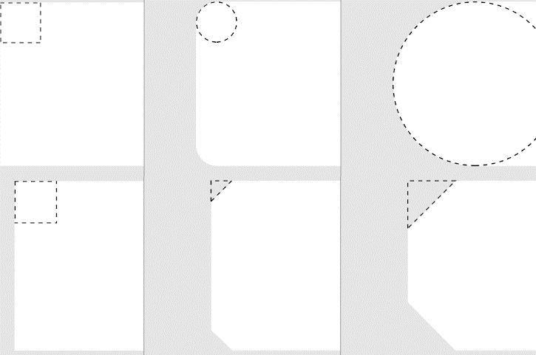
Sample 2
Material UI Guidelines – Shapes
Pick one shape. Solid, Rounded or Cut.
Be consistent with your design decision.
When using Dark and Light theme combination, see the design on both.
Notes:
Guidelines from: https://m2.material.io

Slide 6
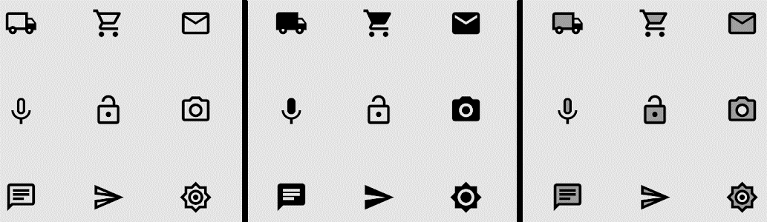
Sample 2
Material UI Guidelines – Icons
Icons should first be meaningful, then aesthetic.
Icons can be outlined, filled and two-toned. Depending on use case.
When an icon is disabled, reduce its transparency or blur it.
Notes:
Guidelines from: https://m2.material.io

Slide 7
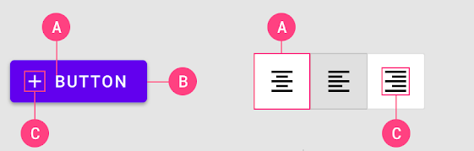
Sample 2
Material UI Guidelines – Buttons
Buttons are very frequently used controls. A button should have:
Short, self-explanatory text
Container with centered contents and equal padding
Optional icon for accessibility
Ideally, a Button should have different colour/tone for each state: Out of focus, on hover, pressed, disabled, toggled.
Notes:
Guidelines from: https://m2.material.io

Slide 8
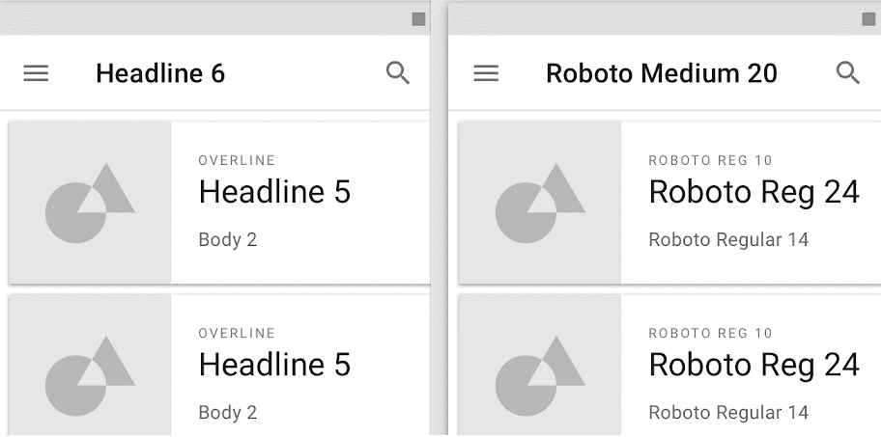
Sample 2
Material UI Guidelines - Typography
Prefer defining text scale with categories (e.g., H1, H3) numbers. If using an uncommon font, put it in assets to load on app launch.
Notes:
Guidelines from: https://m2.material.io

Slide 9
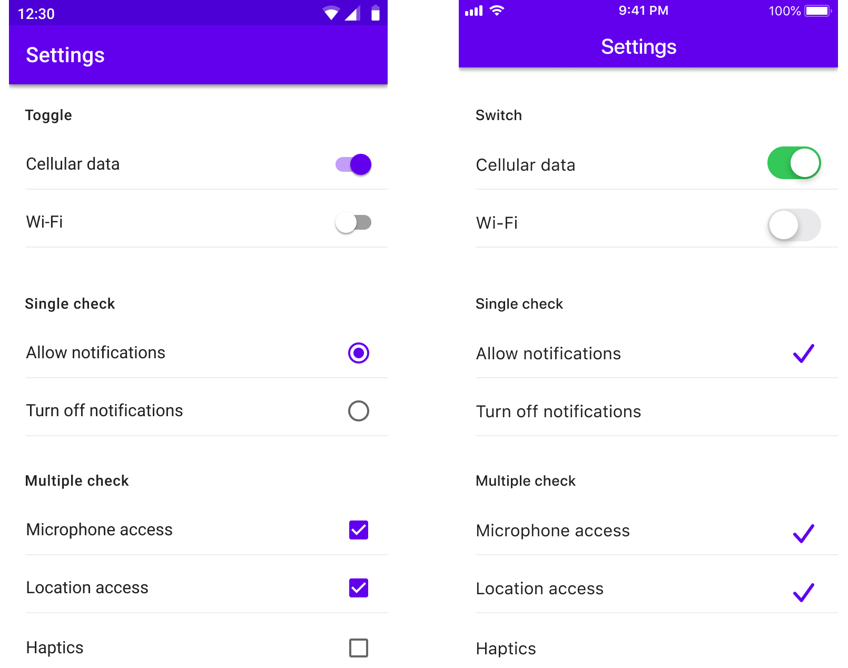
Sample 2
Material UI Guidelines – Cross-compatibility
Cross-platform compatibility. Assess the two screens given.
On left is Android OS and on right is iOS.
The designer ensured that the user gets the same experience on either of the platforms.
Notes:
Guidelines from: https://m2.material.io

Slide 10
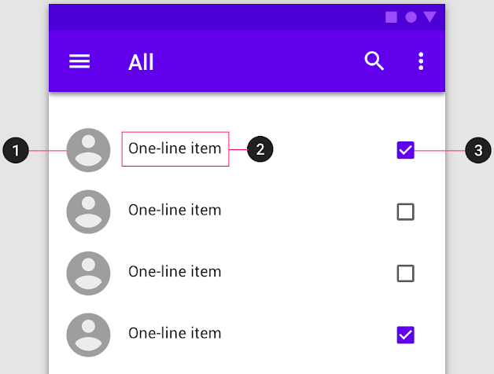
Sample 2
Material UI Guidelines – Lists
Lists should be orderly and actionable
Supporting visual
Primary text
Action control
Notes:
Guidelines from: https://m2.material.io

Slide 11
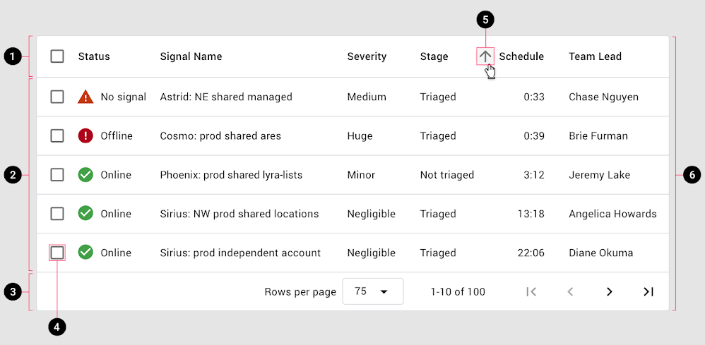
Sample 2
Material UI Guidelines – Data tables
Header
Rows
Pagination
Row checkbox
Sort options
Table Container
Notes:
Guidelines from: https://m2.material.io

Slide 12

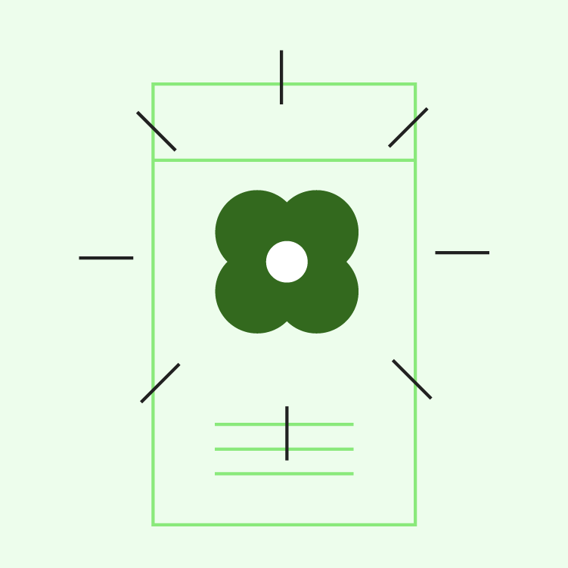

Sample 2
Material UI Guidelines – Imagery
A picture is worth thousand words.
Informative: convey the message
Delightful: look pleasing
Intentional: connect with the story
Notes:
Guidelines from: https://m2.material.io

Slide 13
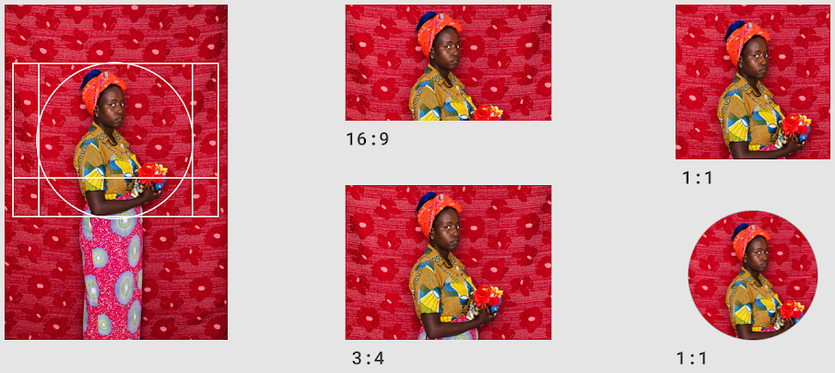
Sample 2
Material UI Guidelines – Imagery
Each image should have a focal point, which should not get lost on changing aspect ratio.
Notes:
Guidelines from: https://m2.material.io

Slide 14

Sample 2
Material UI Guidelines – Imagery
Keep different sizes for different resolutions and use responsive controls to load the right one.
Notes:
More on: Imagery - Material Design

Slide 15
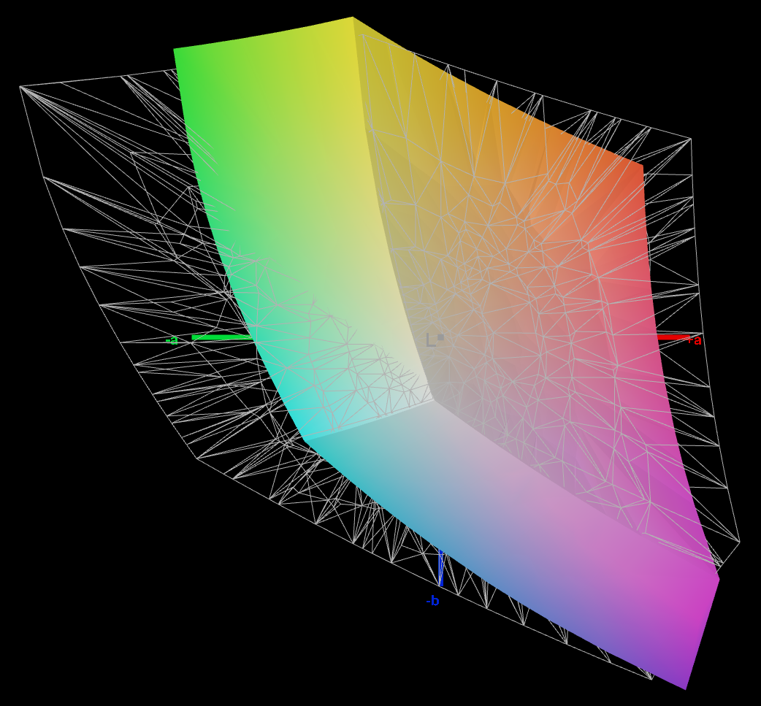
Sample 2
Material UI Guidelines – Target Display
Consider your primary user. Is it going to be on phone, tablet, desktop computer, TV, or a Watch?
From layout, to sizing, to colour selection, all decisions should be focused on primary user.
Featured devices do not have high accuracy. Purple may blend into Violet. Sea green and Teal colours are lookalikes.
Test for sRGB or Adobe RGB coverage.

Slide 16
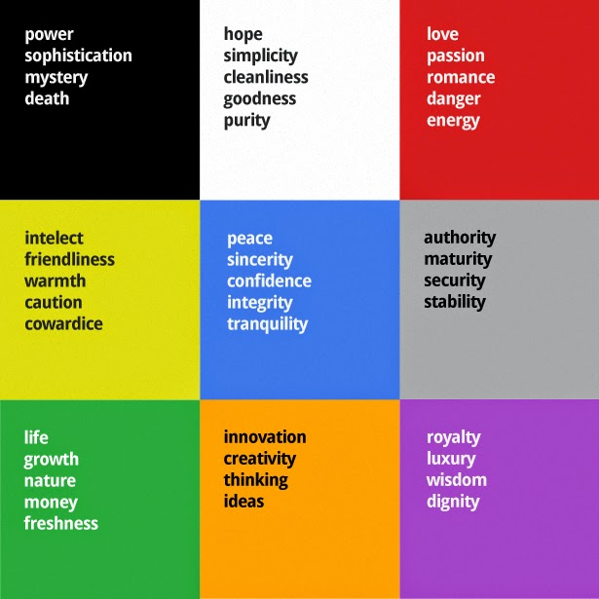
Sample 2
Colour Theory
Psychology: colours have their impression. Look for the right impression, not positive only.
General perception:
RED: energy, danger, love
GREEN: nature, finance, growth
BLUE: peace, confidence
ORANGE: creativity, happiness
PURPLE: style, luxury, spirituality
GRAY FAMILY: power, maturity, security
WHITE: purity, simplicity
Cultural sensitivity: Green and Sophron

Slide 17
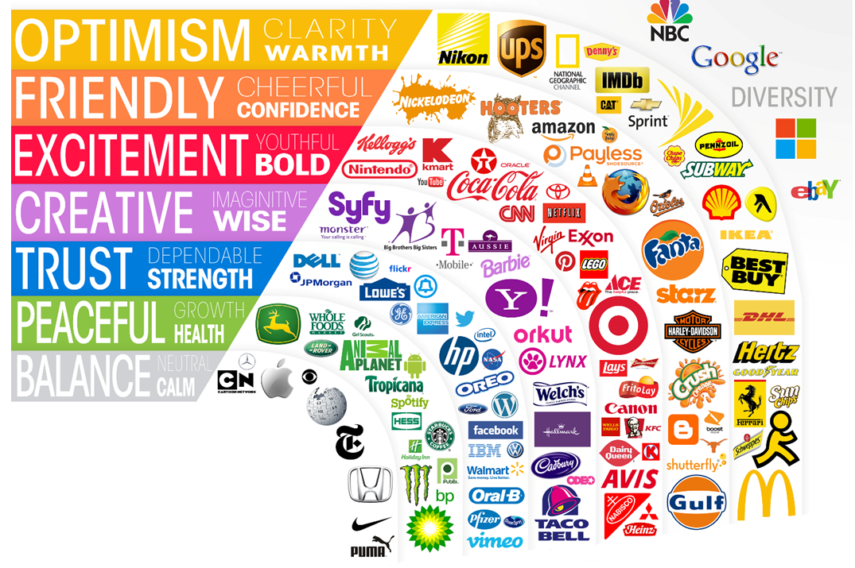
Sample 2
HOW BRANDS COMMUNICATE THROUGH THEIR LOGO

Slide 18
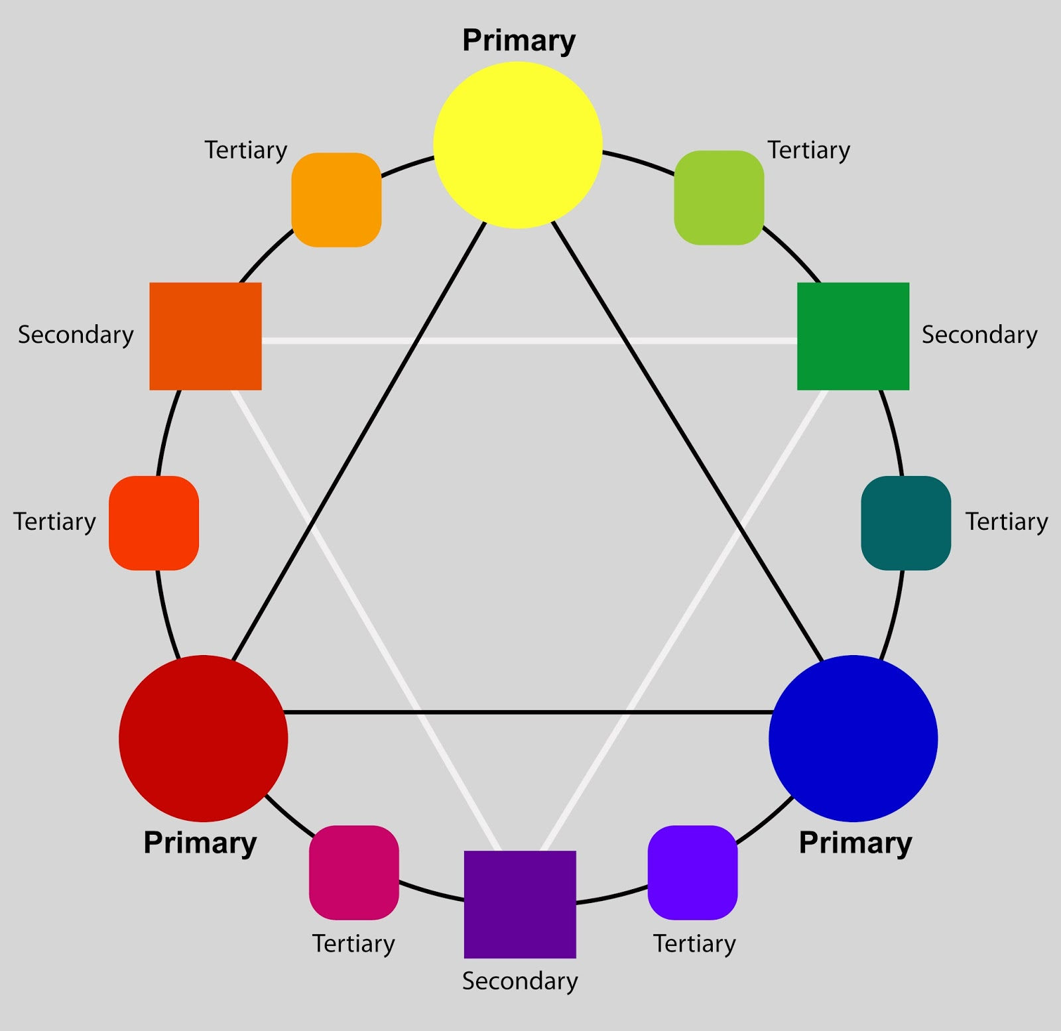
Sample 2
Colour Theory
Colour Wheel
Primary colours form all other colours in nature.
Secondary colours fall in the mid of two primary colours.
Tertiary colours provide variety.
Use a colour wheel to make a theme.
https://coolors.co/color-picker is an excellent source to pick suitable colours for your design.

Slide 19
Sample 2
Colour Theory
Analogous: colours next to each other on the color wheel creates comfortable design
Complementary: colors opposite to each other. Highly energetic, and vibrant, but should not be overused.
Triadic: three colors evenly spaced around the color wheel. Provide richness and high contrast. (I personally recommend this)
Tetradic colors (Double-Complementary): 4 colors together, in the form of two complementary color pairs. Offers rich color combinations.
White space: reduces visual clutter. Maximizing the use of white space does NOT mean maximum white space.

Slide 20
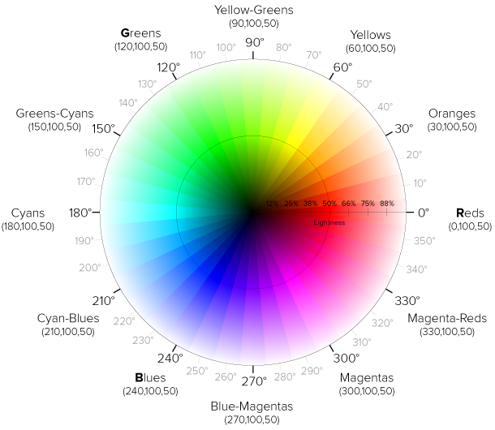
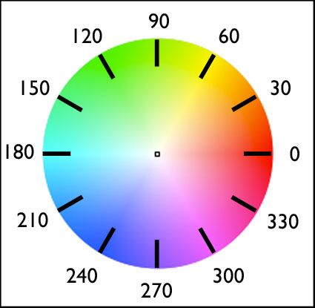
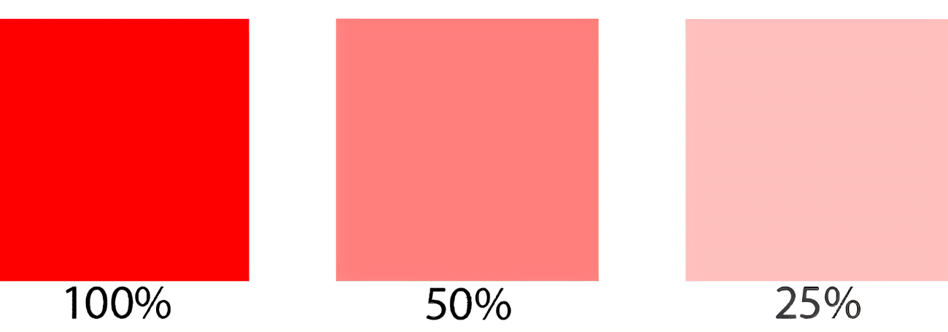
Sample 2
Colour Theory
Properties:
Hue: the name of colour
Saturation: intensity
Brightness: lightness/darkness
Contrast: readability and attention vs soothing
Accessibility: fully/partially colour blind viewer.
Standards:
RBG/RGBA: Red-Green-Blue-Alpha
CMYK: Cyan-Magenta-Yellow-Key (black)
HSL: Hue-Saturation-Lightness
Notes:
Demo colour picking: https://coolors.co/color-picker
Demo accessibility: See: https://coolors.co/contrast-checker

Slide 21
Sample 2
UX-based Design
UX design process:
Research: based on widely accepted practices while keeping uniqueness
Design: based on target audience and their needs
Prototype: as close to the target version as possible
Test: compulsory UAT
Principle-oriented design: visual hierarchy, typography, color schemes
Mobile-specific UI considerations: Responsiveness, Touch and Gesture based interactions, Animations.
Intuitive navigation systems: tab bars, side menus, bottom navigation.
Usability first, Performance second, Gimmicks last.

Slide 22

Sample 2
UX-based Design – Examples
Because something is norm doesn’t make it right. Have a look at the abundance of information in this TV screen.
If user’s focus is required, show one type of info only, preferably following Golden mean ratio.

Slide 23
Sample 2
UX-based Design – Examples
Instagram (intuitive interface, seamless photo sharing)
Airbnb (effortless booking experience)
Spotify (user feedback shaping personalized music recommendations).
Google Maps (clear and intuitive UI), Duolingo (engaging and gamified interface).
Twitter (simple and efficient navigation), Evernote (structured content organization).
Snapchat (engaging augmented reality filters).

Slide 24
Sample 2
UX-based Design – Examples
Microsoft Office (accessible UI and features).
WhatsApp (fast and reliable messaging).
Pinterest (data-driven design improvements leading to increased engagement).
TikTok (short-form video content).
Clubhouse (audio-based social networking).

Slide 25
Sample 2
UX-based Design – Common Errors
Onboarding complexity: user has little clue on how to start.
Too much content: learn from Yahoo, who hasn’t learnt its lesson yet.
Maze-like navigation: let users return home conveniently.
Inconsistent design: opposite of material UI design.
Ignoring end user: the end-user is the most knowledgeable person.

Slide 26
Sample 2
UX-based Design – Use case
How will you design the Baham app for a partially colour-blind person?
What design considerations will you make for a person suffering from Parkinson’s disease?
Choose a theme based on colour theory for a Space Shuttle Simulator.

Slide 27



THANK YOU
Owais Hussain
+92 345-3174270
owais.hussain@kiet.edu.pk
https://www.researchgate.net/profile/Owais-Hussain-3

